Slide 1
Blueprints for building an inclusive company
Built in partnership with Procore’s Senior Director of Global Inclusion and Diversity

Slide 2
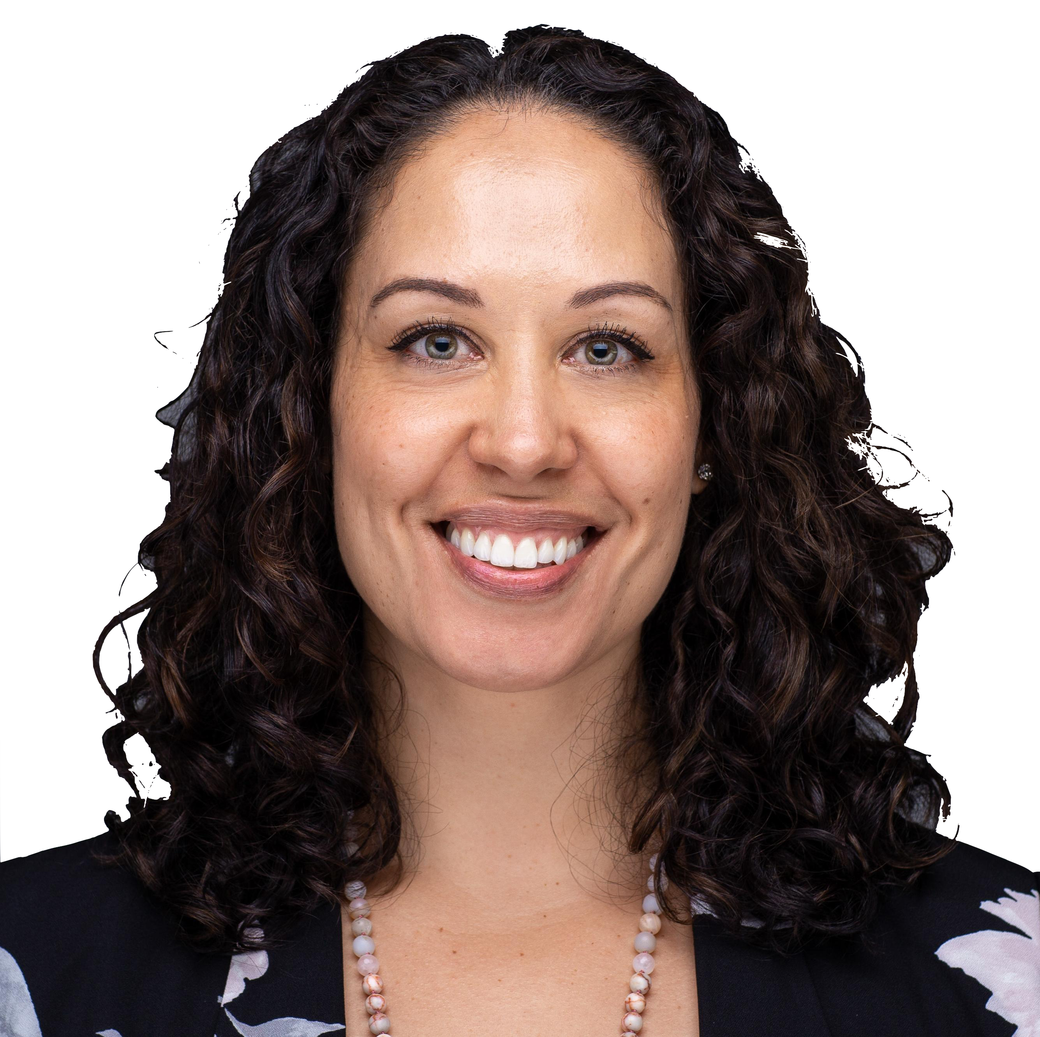
Table of Contents
Overview
Driving business outcomes
The bedrock of company culture
Two types of systems thinking
Inclusive leadership habits
Workshop guide
Initial checklist for building a strategy
  Roadmap template
  Procore example
Recommended reading
“There is no one-size fits all way to improve workplace culture, but in this guide, you’ll get research-backed methods that improve rates of inclusion amongst teams and drive overall systemic change.”
- Valerie Jackson

Slide 3
Culture drives positive business outcomes
Beliefs & Values
Priorities
Comms
Behaviors & Norms
Fast facts
35% of diverse teams financially outperform homogenous ones
70% of diverse companies are more likely to expand into new markets
80% of inclusive teams outperform their peers in team-based assessments
Culture
Notes:
A 2015 McKinsey report on 366 public companies found that those in the top quartile for ethnic and racial diversity in management were 35% more likely to have financial returns above their industry mean, and those in the top quartile for gender diversity were 15% more likely to have returns above the industry mean. Source: https://www.mckinsey.com/business-functions/organization/our-insights/why-diversity-matters
As your business grows, capturing new markets will become increasingly important. Harvard Business Review reports that diverse companies are 70% more likely to report that the firm captured a new market. Source: https://hbr.org/2013/12/how-diversity-can-drive-innovation
Deloitte Australia research shows that inclusive teams outperform their peers by 80% in team-based assessments. Source: https://www2.deloitte.com/content/dam/Deloitte/au/Documents/human-capital/deloitte-au-hc-diversity-inclusion-soup-0513.pdf

Slide 4
The bedrock of company culture
What we say and what we do ultimately impact team cohesion, the conclusions we draw from data, and the products and systems that scale.
  Cognitive culture
The shared intellectual values, norms, artifacts, and assumptions that serve as a guide for the group to thrive.
  Emotional culture
The signals and behaviors we consciously or unconsciously practice that influence employee satisfaction, burnout, teamwork, and even financial performance and absenteeism.
Notes:
Cognitive culture: The shared intellectual values, norms, artifacts, and assumptions that serve as a guide for the group to thrive.
Emotional culture: The signals, behaviors, and habits we consciously or unconsciously practice that influence employee satisfaction, burnout, teamwork, and even hard measures such as financial performance and absenteeism.

Slide 5
Two types of systems thinking
From Thinking, Fast and Slow by Daniel Kahneman
  Type One – Intuition & instinct
  Type Two – Rational
  Unconscious
  Fast
  Associative
  Automatic pilot
  Takes effort
  Slow
  Logical
  Deliberate

Slide 6
How to shift from Type One to Type Two Thinking
Step | Situation | Tip
1. Check for vulnerabilities | Unconscious bias crops when... A team encounters new circumstances; A situation requires discretion; A group works with ambiguous parameters; Participants are stressed in any way. | Schedule “think time” on your calendar given one of these scenarios.
2. HALT – Hungry, Angry, Lonely, Tired | Identify when stressed and overwhelmed; multi-tasking is deleterious to your brain. | Breathe. How can you reduce or mitigate stress before taking action?
3. Compare and contrast | Gather various sets of information For example, when evaluating a resume compare the resume against a group vs. individually. | Source and rely on objective data/criteria.
Notes:
Check where there are vulnerabilities to bias, such as when…
A team encounters new circumstances;
A situation requires discretion;
A group is working with ambiguous parameters or data;
Tip: Schedule “think time” on your calendar given one of these scenarios
HALT – Are you hungry, angry, lonely, or tired?
Stress, overwhelm, and multi-tasking are deleterious to your brain.
Tip: Breathe. Can you reduce or mitigate stress before taking action?
Finally, compare and contrast scenarios or sets of information to slow down your brain.
Tip: Source and rely on objective data/criteria

Slide 7
Catalyst’s EACH framework for inclusive leadership
Value | Behavior | Habit
Empowerment | Enabling direct reports to develop and excel. | Give clarity around roles and responsibilities Provide opportunities for development Create room for failure; celebrate wins
Accountability | Demonstrating confidence in direct reports by holding them responsible for performance they can control. | Set realistic goals with milestones to track progress Use objective criteria to evaluate performance Align Say-Do Ratio
Courage | Acting on convictions and principles even when it requires personal risk-taking. | Be an ally Ask questions Practice active listening
Humility | Admitting mistakes. Learning from criticism and different points of view. | Engage others: “What do you think?” Keep an open mind Ask for feedback on a regular basis

Slide 8
Deloitte’s six elements of inclusive teams
Promoting these values is becoming a new leadership capability
Fairness
Respect
Value
Belonging
Confidence
Inspiration
Notes:
Procore uses trainings, team workshops, and offsites to work through exercises for building psychological safety on a team, built using research from Amy Edmondson and Gallup.
Exercise: Have everyone on the team answer four questions that are provided ahead of time. This is especially valuable for those who process better internally over time, like introverts.
What can the team count on me for?
What is our team's purpose?
What do we want our team's reputation to be?
What do we need to do differently to fulfill our purpose and achieve that reputation?
The first question is answered individually as you go around the circle. Give everyone equal time to talk (5 minutes max).
Then, the remaining questions are answered via group brainstorming. Some teams prefer to have a facilitator external to the team, such as an HR or D&I leader, to help drive the exercise, while other groups prefer to lead it themselves.
When to conduct this workshop:
Although this exercise is useful at any time, it's especially powerful at these moments, such as:
When a team is newly formed
When a new leader/team member joins an existing team
After an organizational shift has created new company or department OKRs
Estimated time:
Prep: 20 minutes

Slide 9
Team workshop: Building inclusive teams (1/3)
Overview
Goal: Gain clarity on team’s purpose and goals; give individuals time to express themselves; build trust and rapport amongst team members.
Fairness
Respect
Value
Belonging
Confidence
Inspiration
Tips:
  Confidence is another term for “psychological safety”, and it’s the most fragile element.
  Psychology safety measures whether one feels they can contribute without social or financial consequence.
  Culture leaders can design engagement survey questions off of these traits to get a benchmark across teams.
Notes:
Procore uses trainings, team workshops, and offsites to work through exercises for building psychological safety on a team, built using research from Amy Edmondson and Gallup.
Exercise: Have everyone on the team answer four questions that are provided ahead of time. This is especially valuable for those who process better internally over time, like introverts.
What can the team count on me for?
What is our team's purpose?
What do we want our team's reputation to be?
What do we need to do differently to fulfill our purpose and achieve that reputation?
The first question is answered individually as you go around the circle. Give everyone equal time to talk (5 minutes max).
Then, the remaining questions are answered via group brainstorming. Some teams prefer to have a facilitator external to the team, such as an HR or D&I leader, to help drive the exercise, while other groups prefer to lead it themselves.
When to conduct this workshop:
Although this exercise is useful at any time, it's especially powerful at these moments, such as:
When a team is newly formed
When a new leader/team member joins an existing team
After an organizational shift has created new company or department OKRs
Estimated time:
Prep: 20 minutes

Slide 10
Team workshop: Building inclusive teams (2/3)
Prep
Identify an external team facilitator, such as an HR or D&I leader
Clear time in everyone’s schedule. This workshop is particularly powerful when…
  A team is newly formed
  A new leader/team member joins an existing team
  After an organizational shift has created new company or department OKRs
Email everyone ahead and explain the workshop goals and questions
Ask everyone to reflect and write on question No. 1 before the workshop
Estimated time:
Prep: 20 minutes
Total workshop: 1.5-2 hours, depending on team size
Notes:
Procore uses trainings, team workshops, and offsites to work through exercises for building psychological safety on a team, built using research from Amy Edmondson and Gallup.
Exercise: Have everyone on the team answer four questions that are provided ahead of time. This is especially valuable for those who process better internally over time, like introverts.
What can the team count on me for?
What is our team's purpose?
What do we want our team's reputation to be?
What do we need to do differently to fulfill our purpose and achieve that reputation?
The first question is answered individually as you go around the circle. Give everyone equal time to talk (5 minutes max).
Then, the remaining questions are answered via group brainstorming. Some teams prefer to have a facilitator external to the team, such as an HR or D&I leader, to help drive the exercise, while other groups prefer to lead it themselves.
When to conduct this workshop:
Although this exercise is useful at any time, it's especially powerful at these moments, such as:
When a team is newly formed
When a new leader/team member joins an existing team
After an organizational shift has created new company or department OKRs
Estimated time:
Prep: 20 minutes

Slide 11
Team workshop: Building inclusive teams (3/3)
Exercise
Questions:
What can the team count on me for?
What is our team's purpose?
What do we want our team's reputation to be?
What do we need to do differently to fulfill our purpose and achieve that reputation?
Steps:
Prepare ahead of time; this is especially valuable for introverts.
Give everyone individual and equal time to answer question No. 1.
Then, answer the remaining questions via group brainstorming.
Capture notes for team planning; commemorate this workshop with a team outing/experience.
Notes:
Procore uses trainings, team workshops, and offsites to work through exercises for building psychological safety on a team, built using research from Amy Edmondson and Gallup.
Exercise: Have everyone on the team answer four questions that are provided ahead of time. This is especially valuable for those who process better internally over time, like introverts.
What can the team count on me for?
What is our team's purpose?
What do we want our team's reputation to be?
What do we need to do differently to fulfill our purpose and achieve that reputation?
The first question is answered individually as you go around the circle. Give everyone equal time to talk (5 minutes max).
Then, the remaining questions are answered via group brainstorming. Some teams prefer to have a facilitator external to the team, such as an HR or D&I leader, to help drive the exercise, while other groups prefer to lead it themselves.
When to conduct this workshop:
Although this exercise is useful at any time, it's especially powerful at these moments, such as:
When a team is newly formed
When a new leader/team member joins an existing team
After an organizational shift has created new company or department OKRs
Estimated time:
Prep: 20 minutes

Slide 12
Initial checklist before building a D&I roadmap
Goal: Gain clarity and alignment on cultural values and business priorities
Fundamentals
  Engage employees at all levels to discuss cultural values and organizational needs
  Administer employee identification and engagement surveys
  Analyze survey results to uncover insights and trends
  Internal rollout and launch of cultural values
  Identify priorities that directly impact talent and employee engagement
Questions to answer
  Mission: Why is Inclusion, Diversity, and Belonging important to the business?
  Objective: Where is our organization ideally headed?
  Pillars: What are our challenges and opportunities for growth?
  Programming: How are we going to get this done with systems and people in place? How are we going to measure our success?

Slide 13
D&I Blueprint – Template
How to map out workplace culture change
Mission: Why is this imperative for the business?
Objective: Where are we headed?
Pillar: What are we focusing on?
Pillar
Pillar
Systems & Process/
People & Behavior
Systems & Process
Systems & Process
Programming
How are we going to get this done?
People & Behavior
People & Behavior
Notes:
Mission: Why is Inclusion, Diversity, and Belonging important to the business?
Objective: Where is our organization ideally headed?
Pillars: What are our challenges and opportunities for growth?
Programming: How are we going to get this done with systems and people in place? How are we going to measure our success?
Why are we doing this? The mission should explain why this culture change is imperative for the business.
Where are we headed? Whereas the mission explains why you’re making change, the objective explains directionally where the organization is headed. Objectives can be measured through qualitative and quantitative measures.
What are we focused on? These pillars are the challenges or areas of opportunity where a culture leader can make an impact on the business. While the mission and objective might stay consistent year-over-year, an organization changes the pillars annually or increases the number over time.
How are we going to get this done? Underneath each pillar are programs that drive change in terms of group systems and individual attitudes and behaviors. Programmatic change must involve process and people. To measure the success of a program overtime, a culture leader can match an individual KPI to each program, system, or habit and see how it improves quarter-over-quarter.

Slide 14
Procore’s D&I Blueprint – Example
Mission: Build an inclusive culture that unlocks the power of diverse teams to drive Procore forward.
Objective: Drive business by improving the employee experience and our value to clients.
Talent Acquisition
People + Culture Development
Marketplace Outreach
Systems & Process
Leverage Talent Acquisition data to understand and improve yields.
Systems & Process
Use surveys to measure inclusion and engagement
Systems & Process
ROI-based selection process for sponsorships
Programming
People & Behavior
Develop inclusive interviewing habits
People & Behavior
Grow employee resource groups and inclusion action teams
People & Behavior
Share learnings and resources with customers

Slide 15
Recommended reading
How diversity can drive innovation, Harvard Business Review
Manage your emotional culture, Harvard Business Review
Creating psychological safety in the workplace, Harvard Business Review
PagerDuty’s Jenn Tejada on recruiting a diverse leadership team, Bessemer Venture Partners
No. 1 inclusion strategy for the workplace, Gallup
Thinking, Fast and Slow, Daniel Kahneman
Better Allies, Karen Catlin
Inclusive leadership: The view from six different countries, Catalyst
Inclusion: A new recipe for business performance, Deloitte AUS
Six signature traits of inclusive leadership, Deloitte
Women in the workplace 2019, McKinsey
Why diversity matters, McKinsey
Sharing gender pronouns at work, Culture Amp
Notes:
Sources:
https://hbr.org/2013/12/how-diversity-can-drive-innovation
https://hbr.org/2016/01/manage-your-emotional-culture
https://hbr.org/ideacast/2019/01/creating-psychological-safety-in-the-workplace
https://www.bvp.com/atlas/pagerduty-s-jenn-tejada-on-recruiting-a-diverse-leadership-team-and-building-an-inclusive-culture
https://www.gallup.com/workplace/247106/no-strategy-true-inclusion-workplace.aspx
https://www2.deloitte.com/content/dam/Deloitte/au/Documents/human-capital/deloitte-au-hc-diversity-inclusion-soup-0513.pdf
https://www2.deloitte.com/us/en/insights/topics/talent/six-signature-traits-of-inclusive-leadership.html
https://www.mckinsey.com/business-functions/organization/our-insights/why-diversity-matters
https://www.mckinsey.com/featured-insights/gender-equality/women-in-the-workplace-2019
https://www.catalyst.org/research/inclusive-leadership-the-view-from-six-countries
https://www.amazon.com/Thinking-Fast-Slow-Daniel-Kahneman/dp/0374533555
https://www.amazon.com/Better-Allies-Everyday-Inclusive-Workplaces/dp/1732723303
https://www.cultureamp.com/blog/sharing-gender-pronouns-at-work/

